Slide 1
RBs
File created on: 5/8/2019 11:48:18 AM

Slide 2
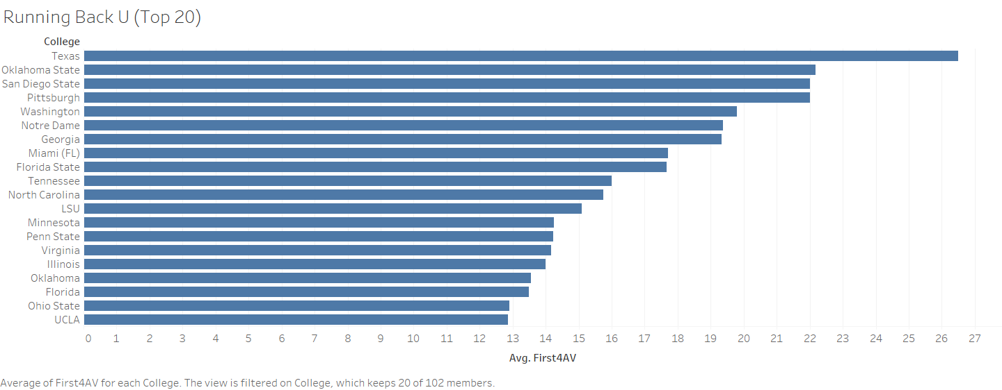

Slide 3
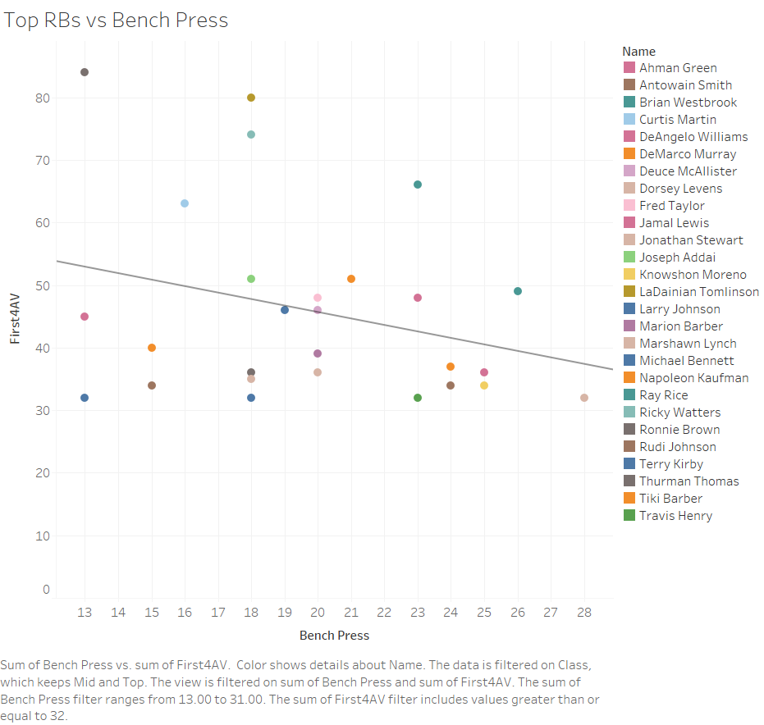

Slide 4
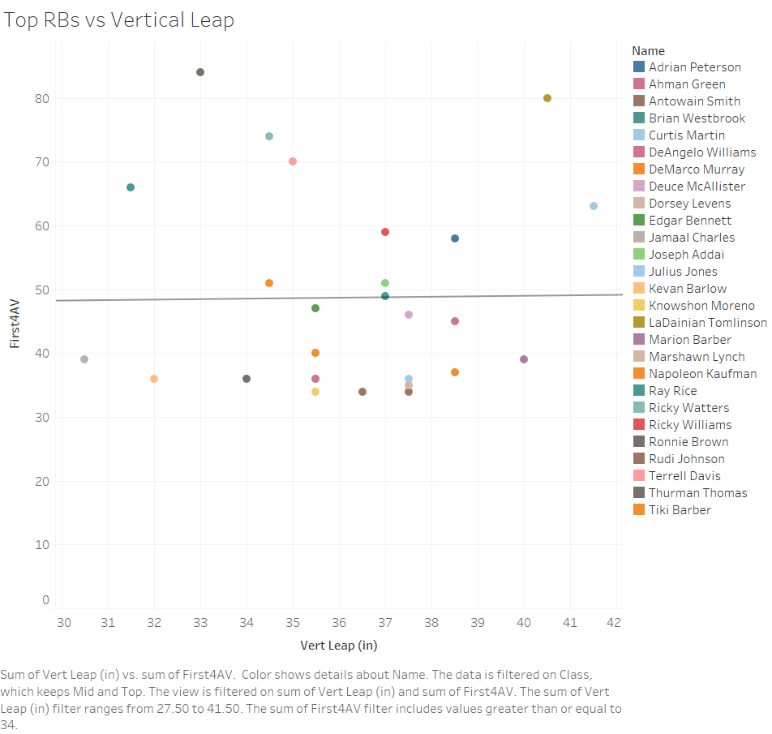

Slide 5
